Slide 1

GOVERNMENT COLLEGE OF ENGINEERING,ERODE
NAME OF THE STUDENT : Muthuramalingam B
NAAN MUDHALVAN REG NO: au731121106034
Under the mentor of
Dr. M. Sathyakala
Assistant professor , Dept of IT Department of Information Technology(IT)
Department of Electronics and Communication Engineering
Government College of Engineering
Erode ,Vasavi College post,TamilNadu-638316,
Affiliated to Anna University ,Chennai.

Slide 2
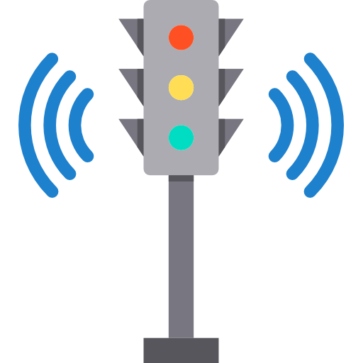
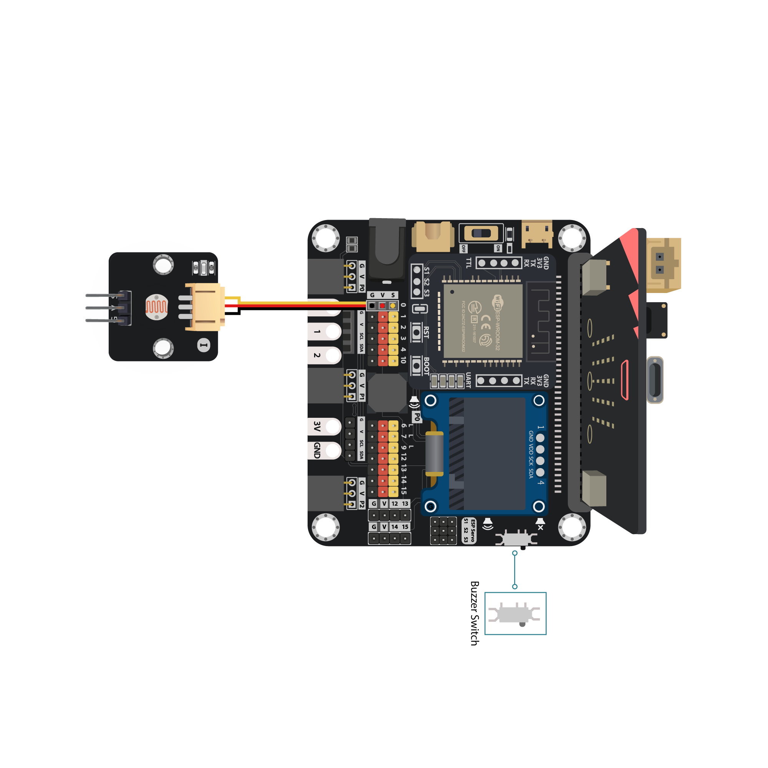

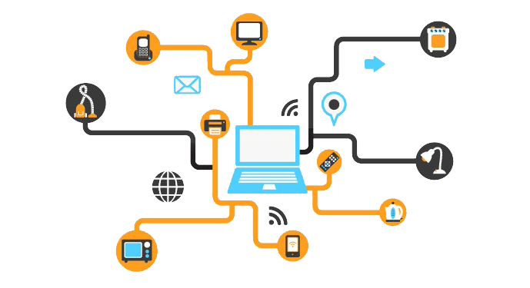
TRAFFIC MANAGEMENT
SYSTEM
PHASE 3
DEVELOPMENT PART-1

Slide 3
import RPi.GPIO as GPIO
from time import sleep
hallpin1=8
#LED1=8
hallpin2=10
hallpin3=12
#hallpin4=24
hallpin11=22
hallpin12=24
hallpin13=26
hallpin21=38
hallpin22=40
hallpin23=37
hallpin31=31
hallpin32=29
hallpin33=23
LED1=16
LED2=18
LED11=32
LED12=36
LED21=35
LED22=33
LED31=21
LED32=19
GPIO setwarnings(False)
GPIO setmode(GPIO.BOARD)
GPIO.setup(LED1, GPIO.OUT, initial=GPIO.LOW)
GPIO.setup(LED2, GPIO.OUT, initial=GPIO.LOW)
GPIO.setup(hallpin1, GPIO.IN)
#GPIO.setup(LED2, GPIO.OUT, initial=GPIO.LOW)
GPIO.setup(hallpin2, GPIO.IN)
GPIO.setup(hallpin3, GPIO.IN)
GPIO.setup(LED11, GPIO.OUT, initial=GPIO.LOW)
GPIO.setup(LED12, GPIO.OUT, initial=GPIO.LOW)
GPIO.setup(hallpin11, GPIO.IN)
GPIO.setup(hallpin12, GPIO.IN)
GPIO.setup(hallpin13, GPIO.IN)
GPIO.setup(LED21, GPIO.OUT, initial=GPIO.LOW)
GPIO.setup(LED22, GPIO.OUT, initial=GPIO.LOW)
GPIO.setup(hallpin21, GPIO.IN)
GPIO.setup(hallpin22, GPIO.IN)
GPIO.setup(hallpin23, GPIO.IN)
GPIO.setup(LED31, GPIO.OUT, initial=GPIO.LOW)
GPIO.setup(LED32, GPIO.OUT, initial=GPIO.LOW)
GPIO.setup(hallpin31, GPIO.IN)
GPIO.setup(hallpin32, GPIO.IN)
GPIO.setup(hallpin33, GPIO.IN)
while True:
print("-----------------------------")
if(GPIO.input(hallpin1)==True):
# GPIO.output(LED1, GPIO.HIGH)
a1=1
print("magnet 1")
print("detected")
if(GPIO.input(hallpin1)==False):
a1=0
print("magnet 1")
print("not detected")
if(GPIO.input(hallpin2)==True):
a2=1
print(" magnet 2")
print(" detected")
if(GPIO.input(hallpin2)==False):
a2=0
print(" magnet 2")
print("not detected")
if(GPIO.input(hallpin3)==True):
a3=1
print(" magnet 3")
print(" detected")
if(GPIO.input(hallpin3)==False):
a3=0
print("magnet 3")
Python script
using
Raspberry pi

Slide 4
print("
detected")
if(GPIO.input(hallpin31)==False):
d1=0
print("
magnet 31")
print("
not detected")
if(GPIO.input(hallpin32)==True):
d2=1
print("
magnet 32")
print("
detected")
if(GPIO.input(hallpin32)==False):
d2=0
print("
magnet 32")
print("
not detected")
if(GPIO.input(hallpin33)==True):
d3=1
print("
magnet 33")
print("
detected")
if(GPIO.input(hallpin33)==False):
d3=0
print("
magnet 33")
print("
not detected")
sum1=a1+a2+a3
sum2=b1+b2+b3
sum3=c1+c2+c3
sum4=d1+d2+d3
print(sum1)
print(sum2)
print(sum3)
print(sum4)
f1=0
f2=0
f3=0
f4=0
if(f1==1)and(f2==1)and(f3==1)and(f4==1):
f1=0
f2=0
f3=0
f4=0
if(f1==0):
if(sum1>sum2)and(sum1>sum3)and(sum1>sum4):
GPIO.output(LED1, GPIO.HIGH)
GPIO.output(LED12, GPIO.HIGH)
GPIO.output(LED22, GPIO.HIGH)
GPIO.output(LED32, GPIO.HIGH)
sleep(15)
GPIO.output(LED1, GPIO.LOW)
GPIO.output(LED12, GPIO.LOW)
GPIO.output(LED22, GPIO.LOW)
GPIO.output(LED32, GPIO.LOW)
print(" not detected")
print("---------------------------------")
if(GPIO.input(hallpin11)==True):
b1=1
print("magnet 11")
print("detected")
if(GPIO.input(hallpin11)==False):
b1=0
print(" magnet 11")
print(" not detected")
if(GPIO.input(hallpin12)==True):
b2=1
print(" magnet 12")
print(" detected")
if(GPIO.input(hallpin12)==False):
b2=0
print(“magnet 12")
print(" not detected")
if(GPIO.input(hallpin13)==True):
b3=1
print(" magnet 13")
print(" detected")
if(GPIO.input(hallpin13)==False):
b3=0
print(" magnet 13")
print(" not detected")
print("------------------------------")
if(GPIO.input(hallpin21)==True):
c1=1

Slide 5
f1=1
if(f2==0):
if(sum2>sum1)and(sum2>sum3)and(sum2>sum4):
GPIO.output(LED11, GPIO.HIGH)
GPIO.output(LED2, GPIO.HIGH)
GPIO.output(LED22, GPIO.HIGH)
GPIO.output(LED32, GPIO.HIGH)
sleep(15)
GPIO.output(LED11, GPIO.LOW)
GPIO.output(LED2, GPIO.LOW)
GPIO.output(LED22, GPIO.LOW)
GPIO.output(LED32, GPIO.LOW)
f2=1
if(f3==0):
if(sum3>sum1)and(sum3>sum2)and(sum3>sum4):
GPIO.output(LED21, GPIO.HIGH)
GPIO.output(LED2, GPIO.HIGH)
GPIO.output(LED12, GPIO.HIGH)
GPIO.output(LED32, GPIO.HIGH)
sleep(15)
GPIO.output(LED21, GPIO.LOW)
GPIO.output(LED2, GPIO.LOW)
GPIO.output(LED12, GPIO.LOW)
GPIO.output(LED32, GPIO.LOW)
f3=1
if(f4==0):
if(sum4>sum1)and(sum4>sum2)and(sum4>sum3):
GPIO.output(LED31, GPIO.HIGH)
GPIO.output(LED2, GPIO.HIGH)
[17/10, 5:53 pm] Mathi: GPIO.output(LED12, GPIO.HIGH)
GPIO.output(LED22, GPIO.HIGH)
sleep(15)
GPIO.output(LED31, GPIO.LOW)
GPIO.output(LED2, GPIO.LOW)
GPIO.output(LED12, GPIO.LOW)
GPIO.output(LED22, GPIO.LOW)
f4=1
sleep(2)

Slide 6
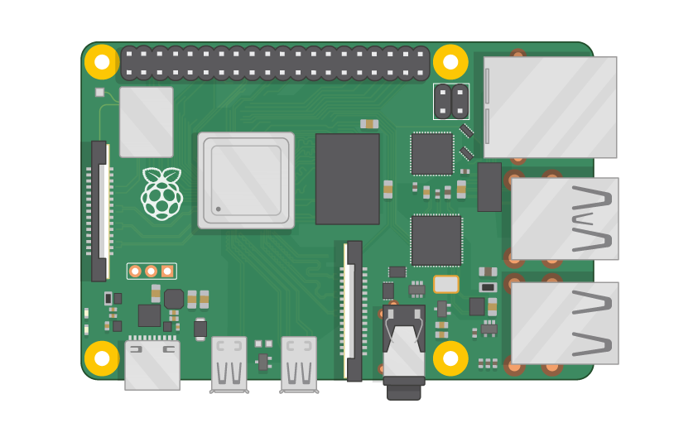
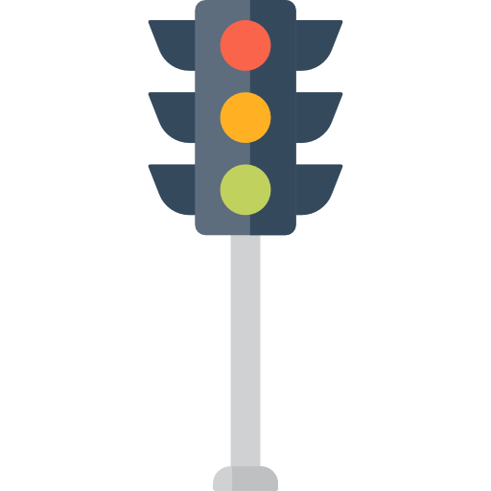
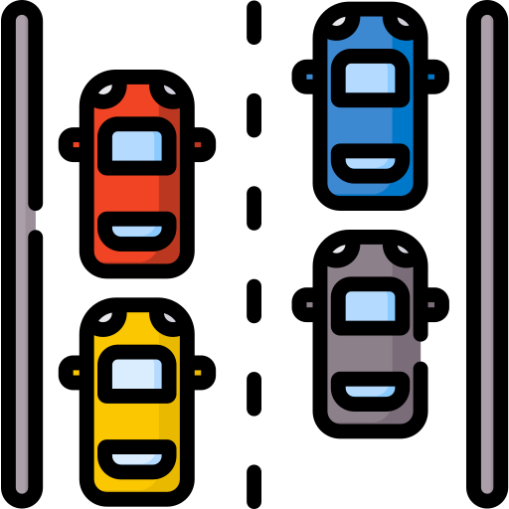
Program Simple Explanation
This Python program appears to be designed to control a system involving magnetic sensors and LEDs using a Raspberry Pi (Rpi GPIO library).
Importing libraries and setting up GPIO:
The code begins by importing the Rpi.GPIO library for Raspberry Pi GPIO control and the time.sleep function for adding delays.It defines various pins for magnetic sensors (hallpin1 to hallpin33) and LEDs (LED1 to LED32).It disables warnings and sets the GPIO mode to use physical pin numbers on the Raspberry Pi.It configures the pins for input (sensors) or output (LEDs) and initializes the LEDs to be initially turned off.

Slide 7
Sensor Reading:
The code enters an infinite loop, where it continuously reads the state of the magnetic sensors .For each sensor, it checks whether it is detecting a magnetic field (True) or not (False) and sets corresponding variables (a1 to d3) to 1 or 0 accordingly It prints messages indicating whether each sensor detected a magnet or not.
Summation:
After reading all the sensors, it calculates the sum of the variables a1, a2, a3, b1, b2, b3, c1, c2, c3, d1, d2, and d3.These sums are stored in sum1, sum2, sum3, and sum4.
LED Control:
The code then checks if f1, f2, f3, and f4 are 0 (initially, they are).For each "f" variable (f1 to f4), it checks the highest sum value among the corresponding sensors (sum1 to sum4).If the current "f" variable is 0, and the corresponding sum is the highest, it turns on a set of LEDs (LED1/12/22/32, LED11/2/22/32, etc.) and waits for 15 seconds. After the wait, it turns off the same set of LEDs and sets the "f" variable to 1 to indicate that the LEDs have been activated. This logic essentially activates LEDs corresponding to the sensors that have the highest magnetic field readings, one "f" variable at a time.

Slide 8
Sleep and Loop:
After all the comparisons are made and LEDs are potentially activated, the code sleeps for 2 seconds before looping back to read the sensor values again . In summary, this program monitors multiple magnetic sensors and activates specific sets of LEDs based on which sensors detect the strongest magnetic fields. The LEDs are turned on for a fixed duration of 15 seconds and then turned off. The program continues to monitor and update the LED states in response to changes in the magnetic field detected by the sensors

Slide 9
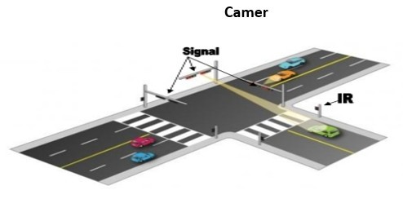
Define Project Scope and Requirements:
Clearly define the goals and requirements of your traffic management system. What traffic data are you collecting? What will the system do with this data? Who are the stakeholders?

Slide 10
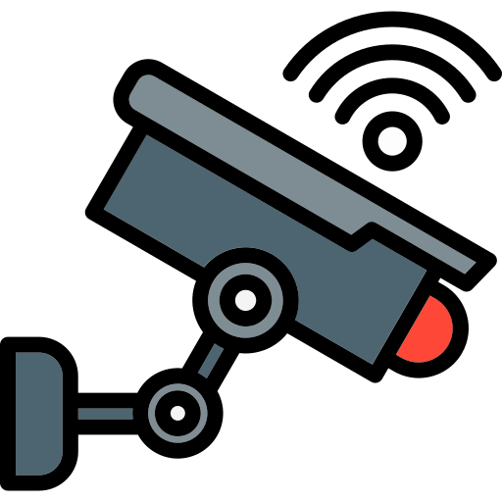

Choose IoT Devices:
Environmental sensors
Air Quality Sensors: These sensors help us know how clean or polluted the air is.
Weather Sensors: Weather sensors keep track of the weather conditions, like rain, snow, or strong winds.
Temperature Sensors: They measure how hot or cold it is. This helps with things like road maintenance, so we know when to de-ice the roads in the winter.
Noise Sensors :These sensors listen for loud sounds like honking or sirens.
CCTV CAMERS
vehicle detection sensors
CCTV cameras are strategically placed at key intersections, highways, and busy roads to monitor traffic conditions in real-time. Operators can observe the flow of traffic, identify congestion or accidents, and take appropriate actions.
Speed Measurement:
You put two sensors on the road, with some space between them. When a car drives over the first sensor, it starts a timer.
Vehicle Classification:
These sensors can also tell you what kind of vehicles are using the road, like cars, trucks, or motorcycles.

Slide 11
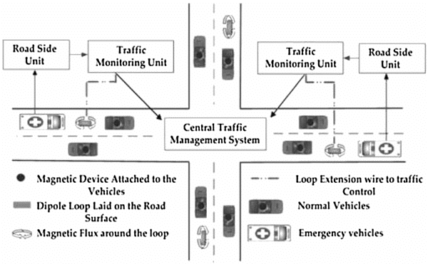
Set Up Hardware and Network Infrastructure:
Install the chosen IoT devices at strategic locations.
Connect these devices to the internet or a local network.
Ensure proper power supply for the devices.

Slide 12
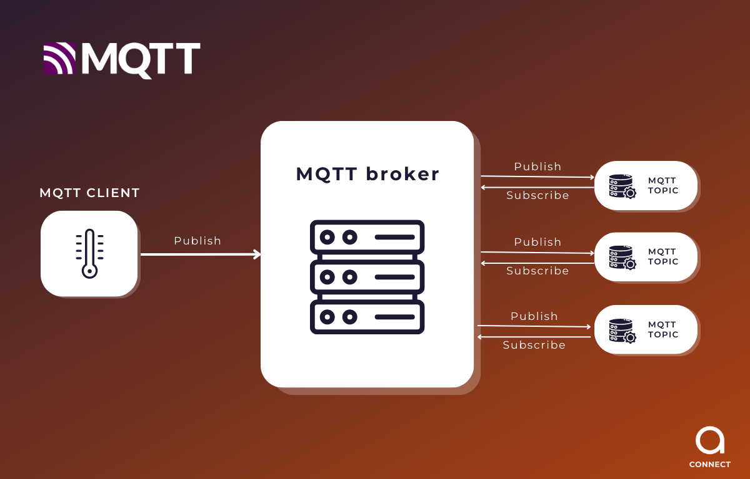
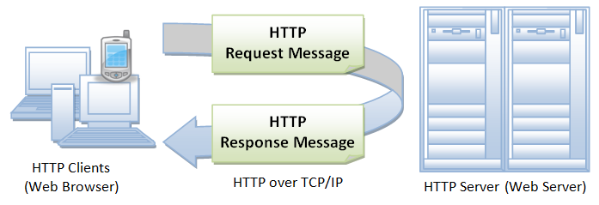
Data Collection and Transmission:
Develop or configure software on the IoT devices to collect data.
Implement a data transmission protocol (e.g., MQTT, HTTP) to send data to a central server or cloud platform.
MQTT
Data Collection: This is like gathering information. In MQTT, it means getting data from different sources, like sensors, and collecting it all in one place.
Transmission: This is like sending the information you collected to where it needs to go. In MQTT, it's about making sure the data gets from one place to another reliably.
HTTP
Data Collection: Think of data collection as gathering information, like taking pictures with your camera. In HTTP, it means getting information from a website or a server on the internet.
Transmission: Transmission is like sending that information to your computer or phone so you can see it. In HTTP, it's about making sure the information from a website or server gets to your device so you can view a webpage or download a file.

Slide 13
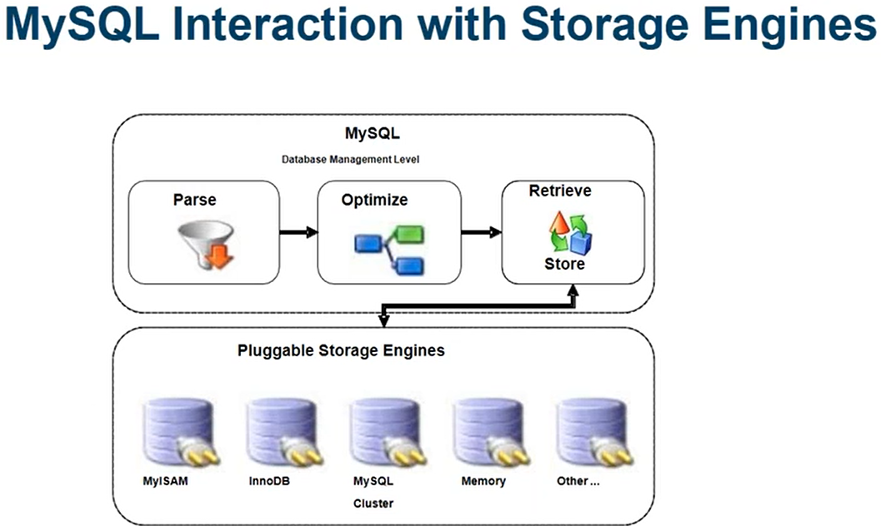
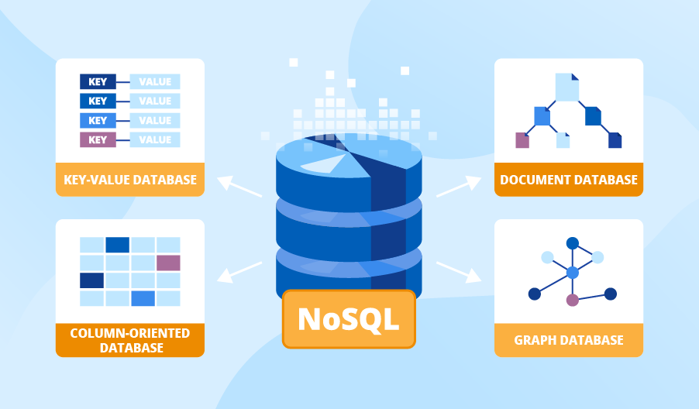
Data Storage and Management:
Set up a database to store the incoming traffic data. You can use databases like MySQL, PostgreSQL, or NoSQL databases depending on your requirements.

Slide 14
Traffic Control and Signal Optimization:
Develop algorithms for traffic signal optimization based on real-time data. Consider traffic flow, congestion levels, and vehicle counts.
Interface with traffic signal control systems to adjust timings.

Slide 15
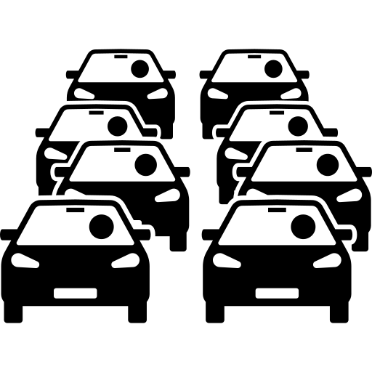
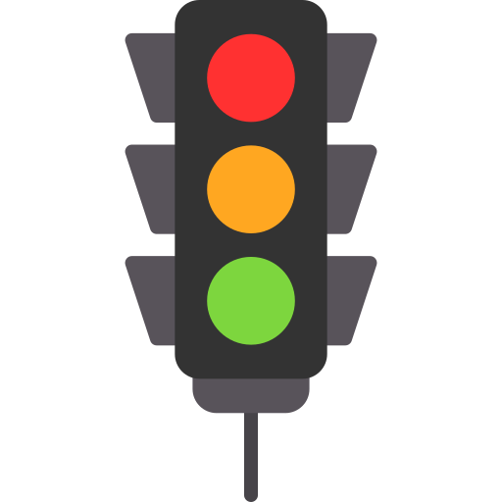
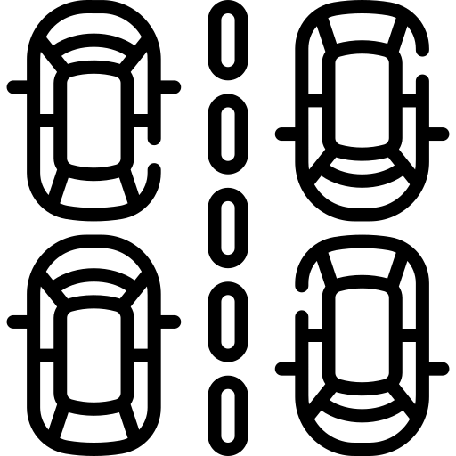
Machine Learning and Predictive Models:
Train machine learning models to predict traffic patterns and anticipate congestion.
Implement anomaly detection algorithms to identify unusual traffic situations.

Slide 16
User Interface and Visualization:
Implement data visualization libraries (e.g., Matplotlib, Plotly) to create informative charts and maps.
Display real-time traffic data, congestion alerts, and suggested alternate routes.
Create a web-based dashboard or mobile app for users, city officials, and traffic engineers.

Slide 17
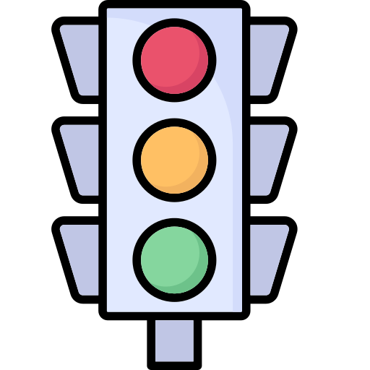
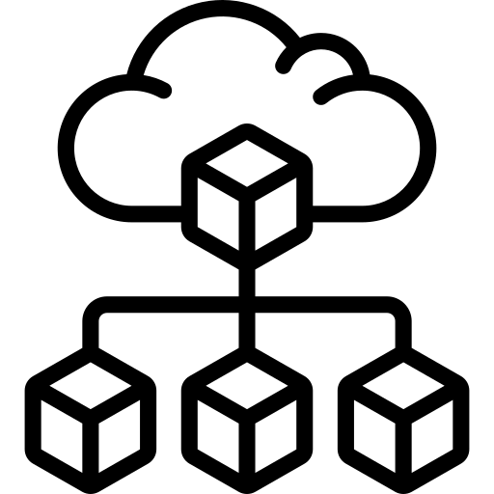
Integration with GPS and Navigation Apps:
Traffic Simulation and Planning:
. Develop a simulation tool to help city planners and engineers optimize traffic flow and plan future road improvements.
Partner with popular navigation apps (e.g., Google Maps, Waze) to provide real-time traffic data and suggest optimal routes.
Infrastructure Monitoring:
Traffic Enforcement:
Implement sensors to monitor the condition of roads and bridges, helping with predictive maintenance..
Use IoT technology for speed detection and red-light camera systems, which can automatically detect and report violations..

Slide 18
Conclusion
Remember to consider the scalability and security of your IoT traffic management system. Additionally, ensure compliance with data privacy regulations and collaborate with local transportation authorities for successful implementation.

